Slide 1
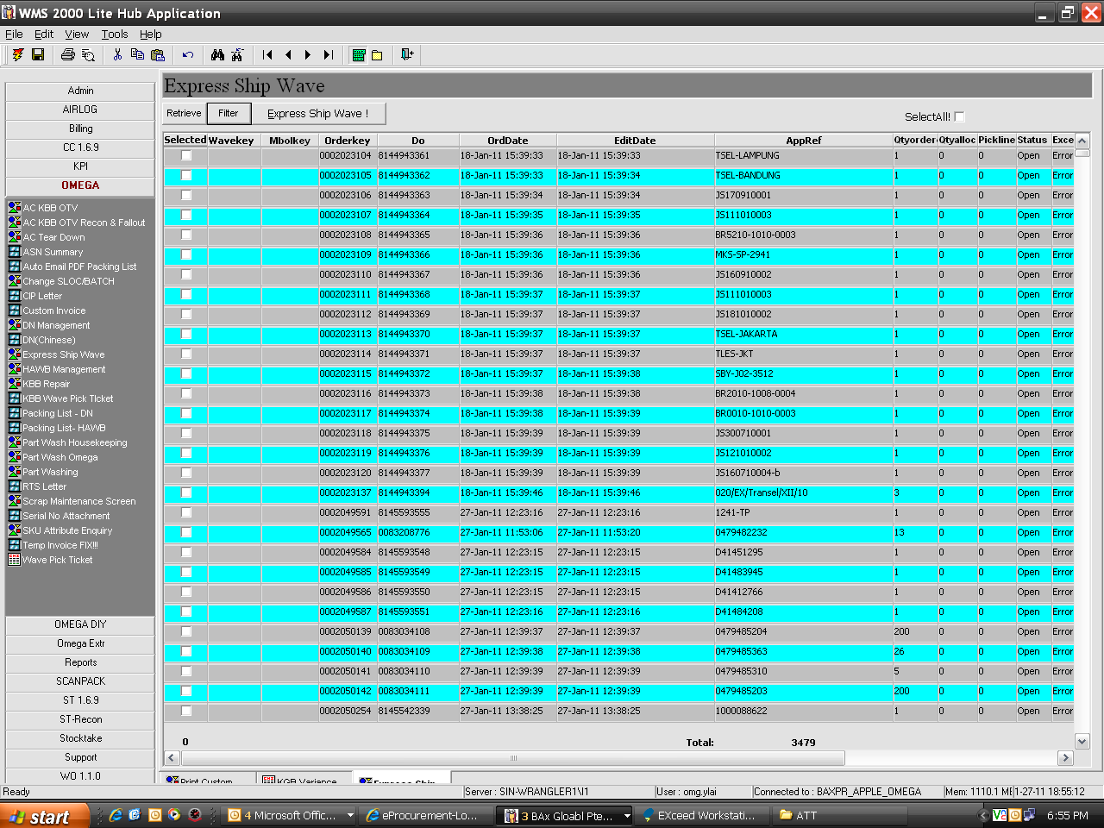
To remove column Apple Ref and pick line
1- To have selection for Wave / DO/ MBOL key / WMS order no
2 - From wave # to wave #

